Slide 1

Blockchains
& Distributed Ledgers
Lecture 05
Aggelos Kiayias
Slide credits: AK, Dimitris Karakostas, Dionysis Zindros, Christos Nasikas

Slide 2

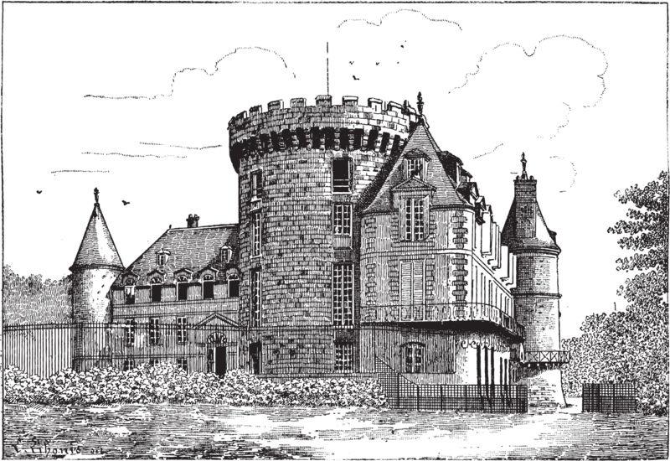
The Byzantine Generals Problem
[LSP82] Leslie Lamport, Robert Shostak, and Marshall Pease. The byzantine generals problem

Slide 3
The Byzantine Generals Problem
retreat
attack
retreat
attack
attack

Slide 4

The Byzantine Generals Problem
retreat
?
retreat
attack
attack

Slide 5
The Consensus Problem

Slide 6
Motivation for the Consensus Layer, I
A transaction history and/or state of the service needs to be agreed by all servers.
Servers may be operated by participants with diverging interests, in terms of the history of transactions and/or state of the service.

Slide 7
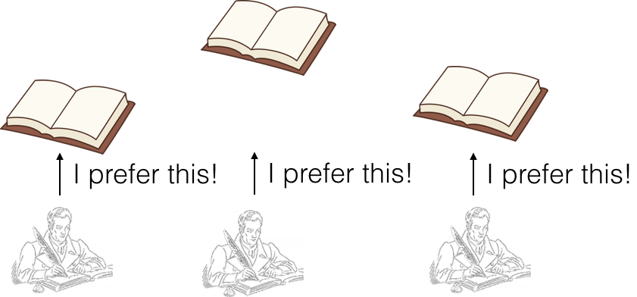
Motivation for the Consensus Layer, II

Slide 8

Consensus : Problem Statement
A number (t) of the participating entities can diverge from the protocol.
This has been called Byzantine behaviour in the literature.
The properties of the protocol are defined in the presence of this “malicious” coalition of parties that attempts to disrupt the process for the “honest” parties.

Slide 9
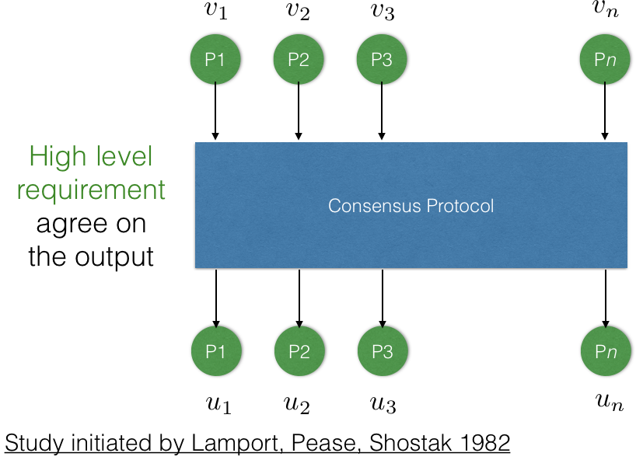
The consensus problem

Slide 10

Consensus Properties
Termination

Slide 11

Consensus Properties
Termination
Agreement

Slide 12
Consensus Properties
Termination
Agreement
Validity

Slide 13

Consensus Properties
Termination
Agreement
Validity
Strong Validity

Slide 14
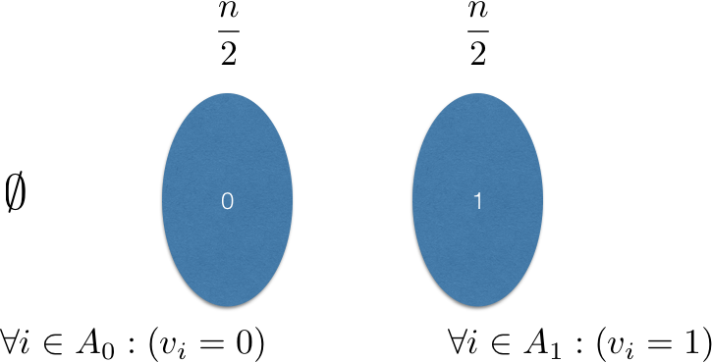
Honest Majority is Necessary, I
Consider an adversary that performs one of the following with probability ⅓

Slide 15
Honest Majority is Necessary, II
If consensus protocol secure:
Adversary corrupts A₀: output of honest parties (that belong to A₁) should be 1.
Adversary corrupts A₁: output of honest parties (that belong to A₀) should be 0.
Adversary corrupts no-one: output of all parties should be the same.
Adversary corrupts each set with prob. ⅓ and instructs corrupted parties to follow the protocol
honest parties cannot distinguish between honest/corrupted parties
If all parties output same value: validity is violated with prob. at least ⅓
If all parties output different value: consistency is violated with prob. at least ⅓

Slide 16
Is Honest Majority Sufficient?
Two important scenarios have been considered in the consensus literature.
Point to point channels. No setup.
Point to point channels. With setup.
The setup provides a correlated private initialization string to each participant; it is assumed to be honestly produced.

Slide 17
Setup and Network
Setup/Network | Synchrony | Partial Synchrony
No Setup | t < n/3 | t < n/3
With Setup | t < n/2 | t < n/3
We know consensus can be achieved, assuming the above bounds on adversarial parties.

Slide 18
The typical setup and network configuration in classical consensus protocols
Setup: a public-key directory
Parties have signing and verification keys for a digital signature scheme.
Each party knows every other party’s verification key.
Network: point-to-point channels
Synchronous, partially synchronous, or asynchronous

Slide 19



Ledger Consensus
C
C
C
…
Ledger Consensus Protocol
…
…
S
S
S
Related to state machine
replication [Sch90]
Notes:
Now an important variation of the problem is what we call ledger consensus.

Slide 20


Ledger Consensus Properties
Consistency:
Liveness:
Transaction Input of party j at time t consistent with its log
Log of party j at time t
[.. and there are more properties of interest here.. e.g., fairness of transaction serialization, exporting a clock,... ]

Slide 21
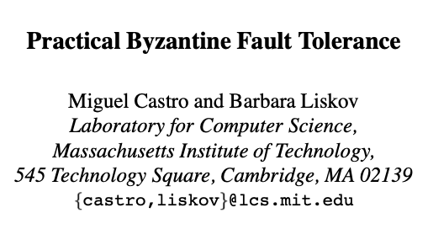

Solving ledger consensus
(solving SMR, actually)
Its operation & threat model features:
Asynchronous communication, point-to-point channels.
Authenticated setting: parties are able to identify message sources
Fixed number of participants
Computationally bounded adversary in the sense it cannot forge digital signatures.
Setup assumption: PKI
Adversary controls less than ⅓ of participants (required)
No privacy properties for servers
communication complexity O(n²) in best case, where n is the number of participants
No protocol incentives

Slide 22
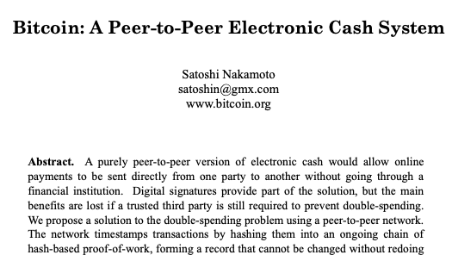

Solving ledger consensus, II
runs uninterruptedly over the Internet since 2009 assuming bounded delays

Slide 23
Bitcoin Blockchain
A ledger consensus protocol, where
participants called “miners” run an intensive proof of work (PoW) algorithm at every step.
Its threat model features:
Bounded delay communication by ‘diffusion’ of messages (no point-to-point channels)
No ability to identify message sources - unauthenticated setting
Unknown and fluctuating number of participants … dynamic availability
Computationally bounded adversary possessing ~< 50% of resources
Setup: public random string (no PKI)
Tolerates potential spikes of adversarial majority… self-heals
Privacy for maintainers… protocol transcript maintains anonymity/unlinkability of participants
Optimal amortized communication complexity of single multicast per block.
Protocol incentivizes participants to run the software
When bitcoin appeared the above threat model was an unexplored territory for consensus
The threat model was also not spelled out anywhere in the original works — protocol was given as is
[Nakamoto2009]
Notes:
Note that n is large.

Slide 24
The Bitcoin “backbone”
The core of the bitcoin protocol
The chain validation predicate.
The chain selection rule (max-valid)
The proof of work function.
The main protocol loop
Protocol is executed by “miners”
[GKL2015] Garay, Kiayias, Leonardos. The Bitcoin Backbone Protocol: Analysis and Applications.

Slide 25
Model
Assume there are n parties running the protocol
Synchronous
Each party has a quota of q queries to the function H(.) in each round
A number of t parties are controlled by an adversary (a malicious coalition)
Security arguments are for any adversary

Slide 26
ctr
x
s
counter
(PoW witness
content
pointer to previous block

Slide 27
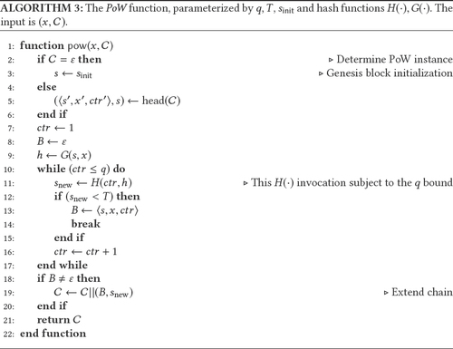

Slide 28
Blockchain
B₀ = <⊥, x₀, ctr₀>
B₁ = <s₁, x₁, ctr₁>
…
B_{n} = <s_{n}, x_{n}, ctr_{n}>
genesis block
s₁ = H(ctr₀, G(x₀, “label”)) = s_{init} s_{i} = H(ctr_{i-1}, G(x_{i-1}, s_{i-1}))
x_{C} = <x₀, x₁, … , x_{n}> C^{⌈k} = <B₀, B₁, … , B_{n-k}>
C = <B₀, B₁, … , B_{n}>
chain
head

Slide 29
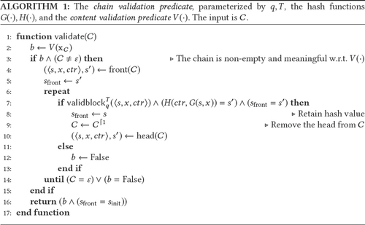

Slide 30
ctr
x
s
counter
(PoW witness
content
pointer to previous block
validblock predicate: (H(ctr, G(x, s)) < T) ∧ (ctr ≤ q)
hash functions
upper bound
(no of hashes per round)
PoW target

Slide 31
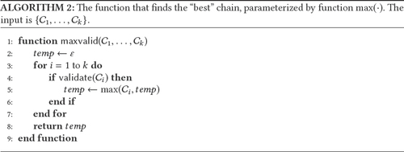

Slide 32
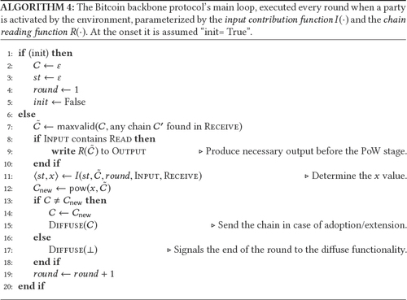

Slide 33
Basic Properties
Common Prefix
Chain Quality
Chain Growth

Slide 34
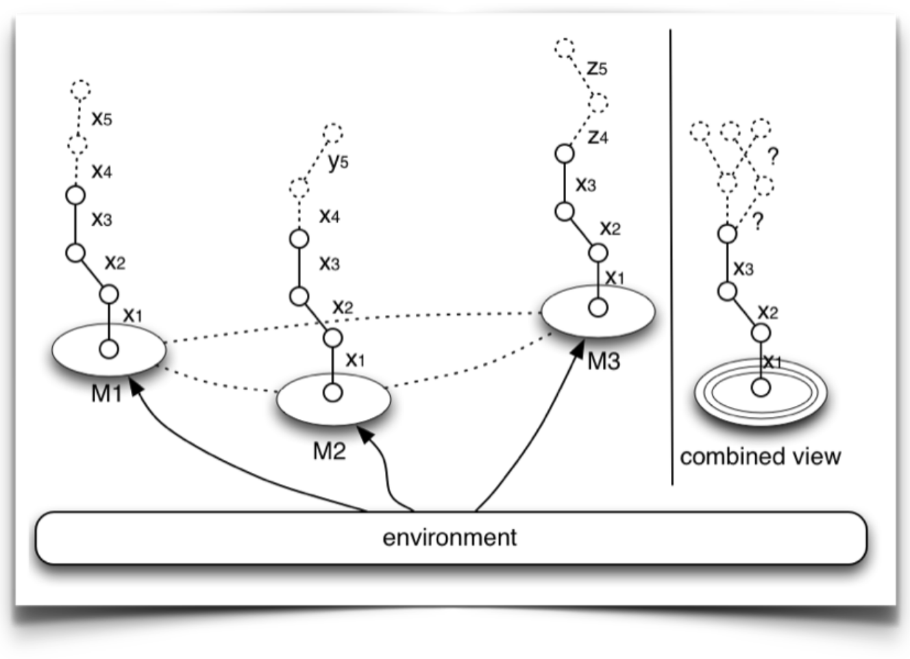
Common Prefix, Ι

Slide 35
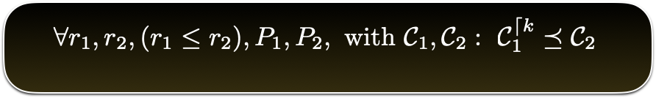
Common Prefix, ΙΙ
(strong common prefix / consistency)
The property holds true, in a probabilistic sense, with an error that decays exponentially in k

Slide 36
Racing Attacks
Attacker splits from the main chain and tries to overtake the “honest chain”
=> Common prefix breaks
Intuition why the attack is a small probability event:
concentration bounds help honest parties

Slide 37
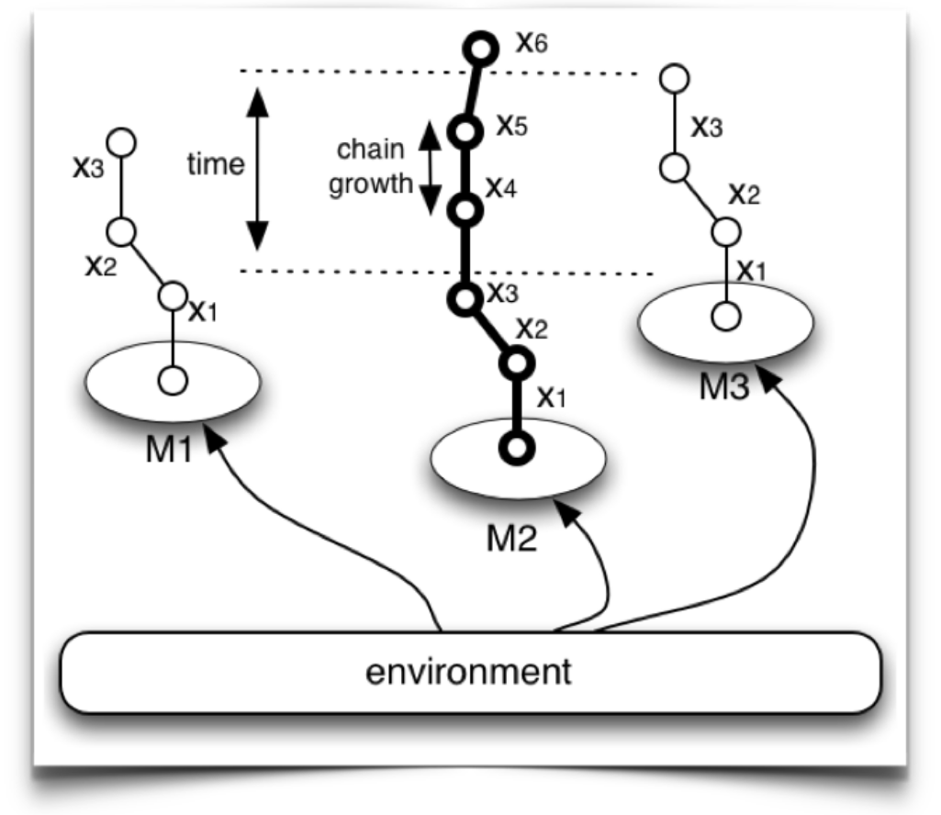
Chain Growth, I

Slide 38
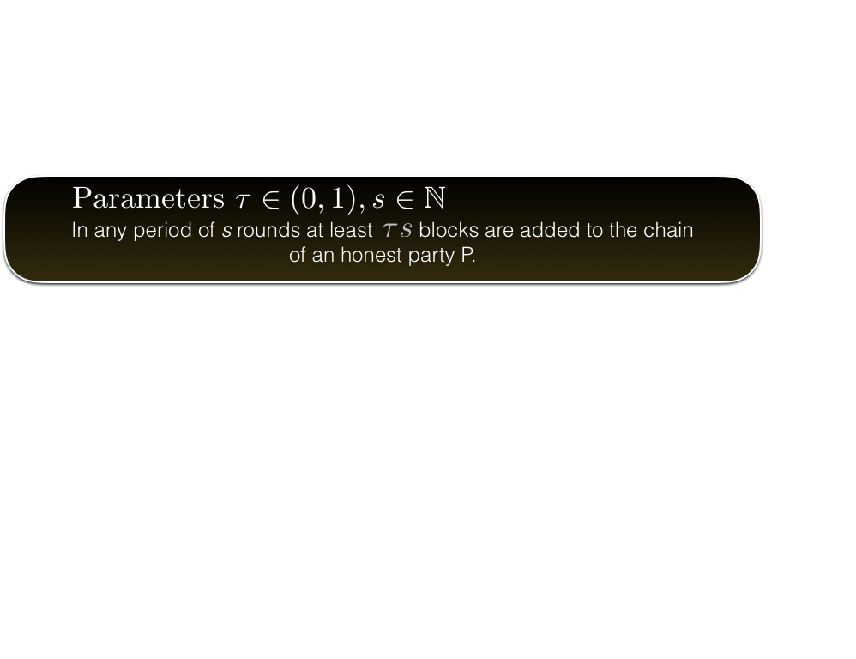
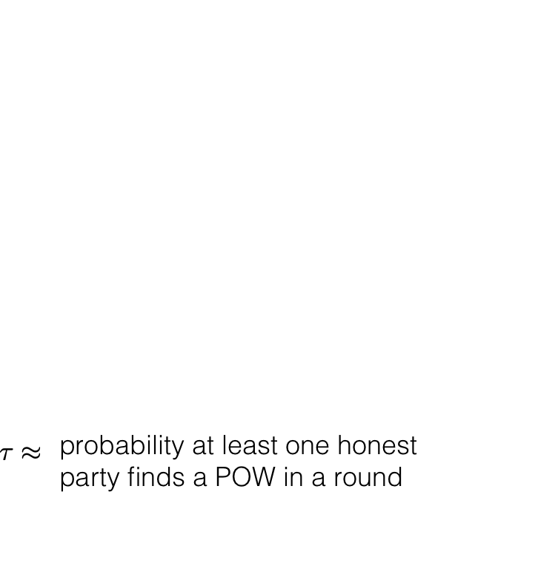
Chain Growth, II
The property holds true in a probabilistic sense with an error probability that exponentially decays in s

Slide 39
Abstention Attacks
Attacker stops producing blocks
=> Chain growth stops
Intuition why the attack is a small probability event:
honest parties will eventually issue blocks

Slide 40
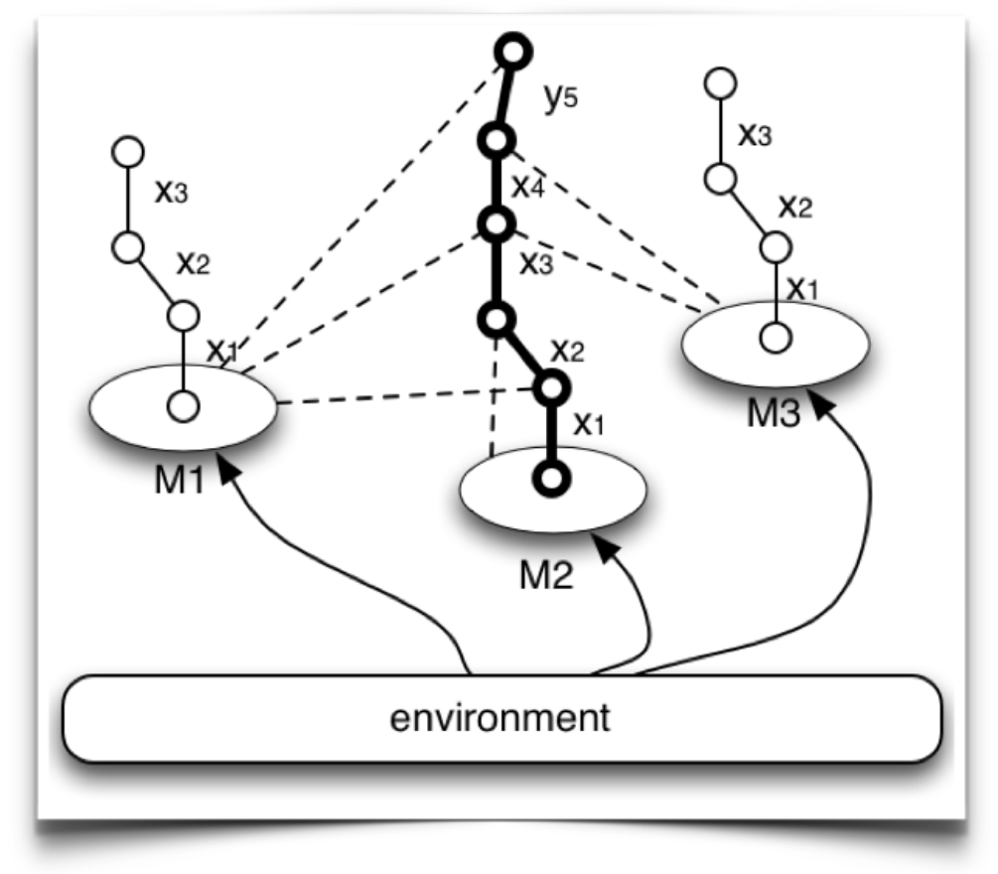
Chain Quality, I

Slide 41
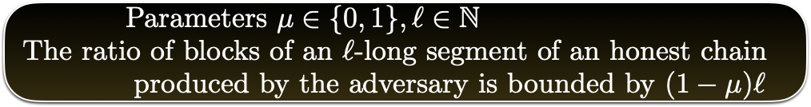
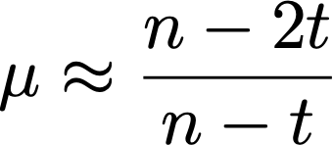
Chain Quality, II
The property holds true probabilistically with an error that exponentially decays in ℓ

Slide 42
Block Withholding Attacks
Attacker mines privately and releases their block at the same time an honest party releases its own block
Assuming honest propagation favours the adversary, the honest block is dropped, reducing chain quality
Intuition why the attack is a small probability event:
over time the adversary cannot produce blocks at the same rate as honest parties (to compete with them)

Slide 43
Establishing a Ledger Consensus from a Blockchain
Consistency ← (strong) Common Prefix
need to exclude k most recent blocks
Liveness ← Chain Growth and Chain Quality
leave sufficient time for chain to grow
apply chain quality to ensure that at least one honest block is included

Slide 44
Ledger Consensus vs. Consensus
What is the connection?
ledger is an ever-going protocol with inputs (e.g., transactions) continuously coming from also external sources
consensus is a one-shot execution
Is it possible to reduce consensus to the ledger? Is it possible to reduce the ledger to consensus?
(See the GKL paper for more details)

Slide 45
Hash operations
Consider a regular PC (30 MHash / sec)
With expectation of 2⁷⁸ hashing operations (current difficulty – 10/24), mining a block will require ~ 320 million years.
https://en.bitcoin.it/wiki/Non-specialized_hardware_comparison
https://www.coinwarz.com/mining/bitcoin/difficulty-chart

Slide 46
Parallelising mining
Bitcoin’s Proof of Work can be parallelized
Parties tend to form mining pools
Instead of working separately, work together to solve PoW for the same block.
By collecting “shares” (small hashes of the block that are not quite as small as needed) one can prove how much they contributed.

Slide 47
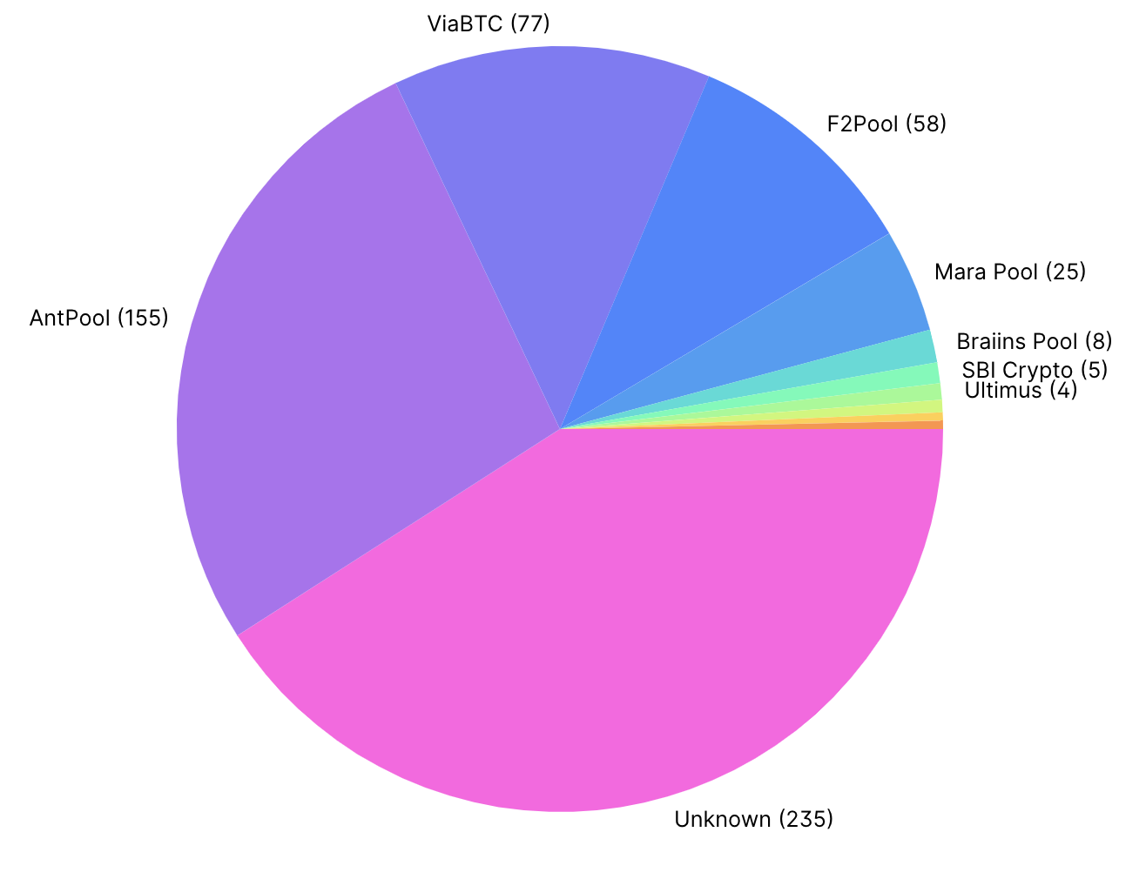
Bitcoin mining pools
https://www.blockchain.com/pools

Slide 48
Recall: PoW algorithm
int counter;
counter = 0
while Hash(data, counter) > Target
increment counter
return counter

Slide 49
Dynamic Availability
So far: n nodes maintain the blockchain
This number may change over time:
new users enter the system
existing users leave
The change over time can be dramatic
The Bitcoin blockchain handles this, by adjusting the target (difficulty) of the Proof of Work algorithm

Slide 50
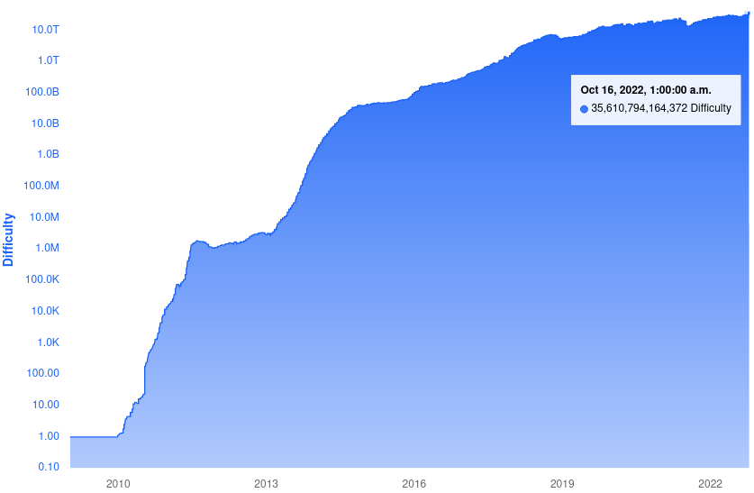
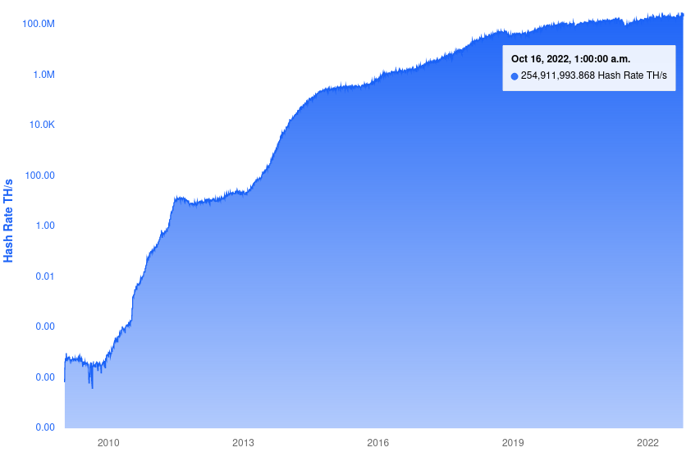
Target difficulty / Total hash rate over time
Notes:
EH/s = exa hash per second. Exa = 10^18
Difficulty is measured in multiples of smallest difficulty : 2^(32) operations approximately to find a block.
Log scale is in base 10

Slide 51
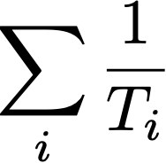
Adjusting the difficulty
“maxvalid” rule is changed s.t. parties adopt chain with highest difficulty linearly related to:

Slide 52
The f parameter [GKL15]
f = probability of producing a block in a round of interaction
f depends on:
target T
number of miners
duration of round
If f becomes too small, parties do not progress
Chain growth slows
Liveness is hurt
If f becomes too large, parties “collide” often
Attacker can exploit network scheduling of message delivery to create forks
Consistency is hurt
To resolve this dynamically, Bitcoin recalculates T to keep f constant

Slide 53
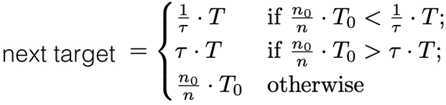
Target recalculation
Recalculation occurs at the end of every “epoch”
m: epoch length in blocks (in Bitcoin: 2016)
n₀: estimation of number of ready parties at the system’s onset (party=CPU)
T₀: initial target
τ: recalculation threshold parameter (in Bitcoin: 4)
T: target in effect
n = m/(pTM): the “effective” number of parties in the epoch
M: last epoch’s duration based on block timestamps
pT: probability of a single party being successful in PoW in a round

Slide 54
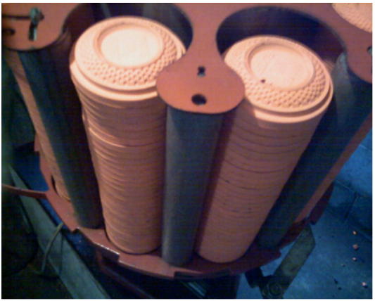
Clay pigeon shooting game

Slide 55
Clay pigeon shooting game
Suppose you shoot on targets successively against an opponent
your success probability: p = 0.3
your opponent’s success probability: q = 0.4
you shoot in sequence 1000 targets
winner is the one that got the most hits
What is your probability of winning?

Slide 56
Analysis, I
Consider the random variable Z_{i} = X_{i} + X_{i-1} + … + X₁
X_{i}=1 you get ahead, probability p(1-q)
X_{i}=-1 opponent gets ahead, probability q(1-p)
X_{i}=0 draw, probability pq + (1-p)(1-q)
E[X_{i}] = p(1-q) - q(1-p) = p – q < 0
E[Z_{n}] = n(p – q)
Hoeffding inequality states: Pr[Z_{n} => ε + n(p – q) ] <= exp(- ε² / 2Bn), for ε>0 and -B <= X_{i} <= B
Set ε = n(q – p), B=1, and we obtain Pr[Z_{n} => 0] <= exp(- (q-p)² n/ 2)
For our numbers (q=0.4, p=0.3, n=1000), Pr[Z_{n} => 0] <= 0.007 <= 1%

Slide 57
Analysis, II
Now you are given a choice:
decrease the size of the clay pigeon target by a ratio β
augment your “kills” by multiplying with 1/β
your accuracy is linear with β
your opponent will keep playing in the same way as before
Do you prefer to play like this or it makes no difference?

Slide 58
Analysis, III
Consider the random variable Z_{i} = X_{i} + X_{i-1} + … + X₁
X_{i}=1/β you get ahead, probability βp(1-q)
X_{i}=-1 opponent gets ahead, probability q(1-βp)
X_{i}=1/β-1 both win, probability βpq, and X_{i}=0 both lose, probability (1-βp)(1-q)
E[X_{i}] = (1/β)βp(1-q) - q(1-βp) + (1/β-1)βpq = p – q < 0
E[Z_{n}] = n(p – q)
Hoeffding inequality states: Pr[Z_{n} => ε + n(p – q) ] <= exp(- ε² / 2Bn), for ε>0 and -B <= X_{i} <= B
Set ε = n(q – p), B=1/β, and we obtain Pr[Z_{n} => 0] <= exp(- β(q-p)² n/ 2)
Observe: as β -> 0, tail bound deteriorates to <=1.

Slide 59
The Difficulty Raising Attack
The recalculation threshold (τ) is essential
Without it, an adversary that has a minority of hashing power:
Creates a private, artificially difficult chain
Similar to clay pigeon shooting game, this increases the variance in its block production rate
Overcoming the chain of the honest parties becomes a non-negligible event
[B13] Lear Bahack. Theoretical Bitcoin Attacks with less than Half of the Computational Power (draft)

